Slide 1
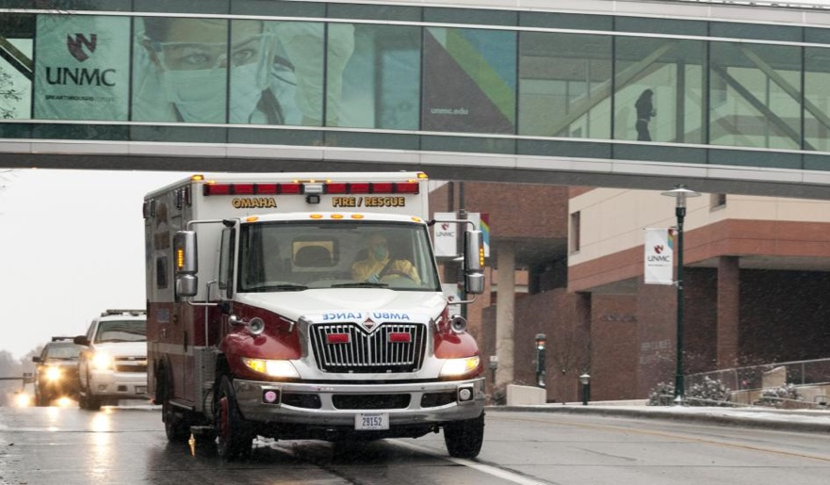
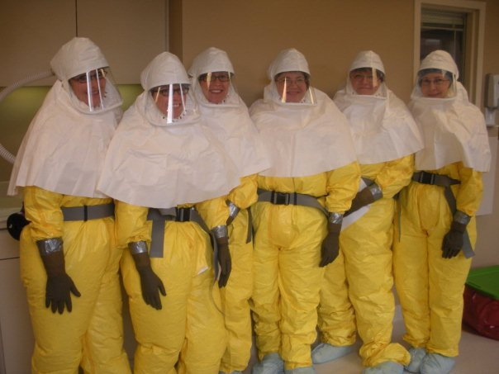
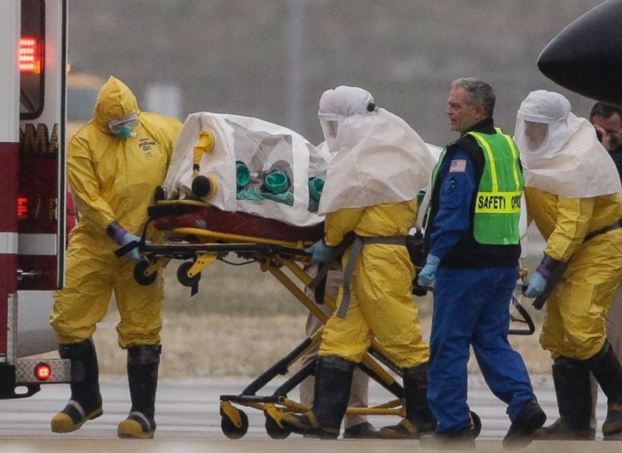
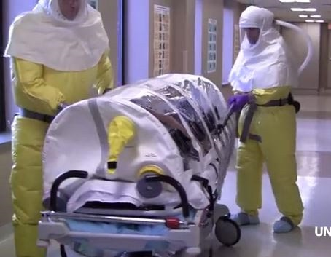
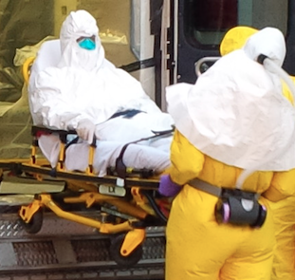
Transporting Patients with Highly Hazardous Communicable Diseases

Slide 2
Global Ebola Virus Disease Outbreak
New York Times 2015
At least 24 internationally evacuated
Ashkenas et al. "How many Ebola patients have been treated outside of Africa?" The New York Times (2015). http://nyti.ms/1ofydUH.
Notes:
New cases in Sierra Leone, Guinea, Liberia
9177 total case fatalities
488 healthcare worker deaths in West Africa (as of Feb 8, 2015) (WHO, 2015)
24 evacuated to U.S., Europe
UNMC
3 confirmed with EBOV
2 high-risk exposures transports
= 5 total HCW evacuations from West Africa

Slide 3
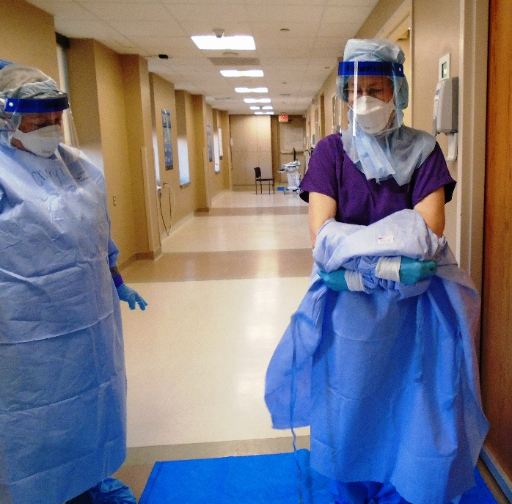
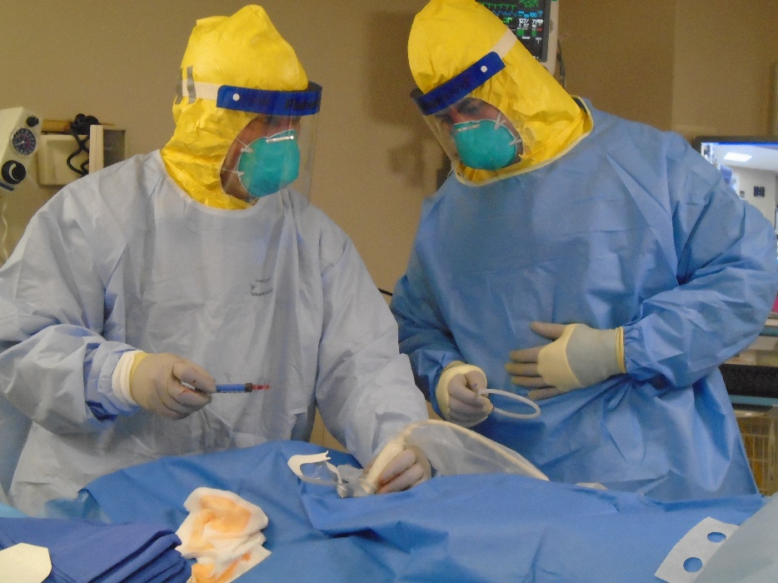
NBU Activation 2014
September 5, 2014: Received a patient diagnosed with EVD, medically evacuated from Liberia
October 6, 2014: Received a patient diagnosed with EVD, medically evacuated from Liberia
November 15, 2014: Received a patient diagnosed with EVD, medically evacuated from Sierra Leone

Slide 4
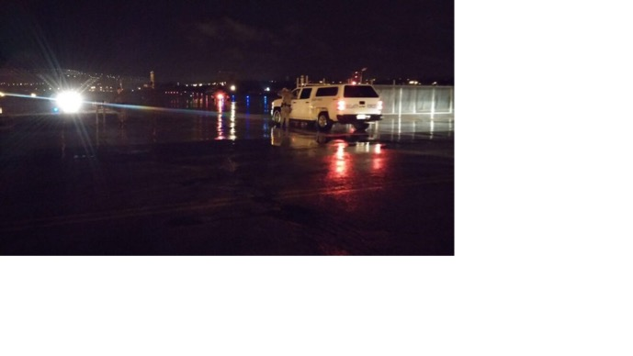
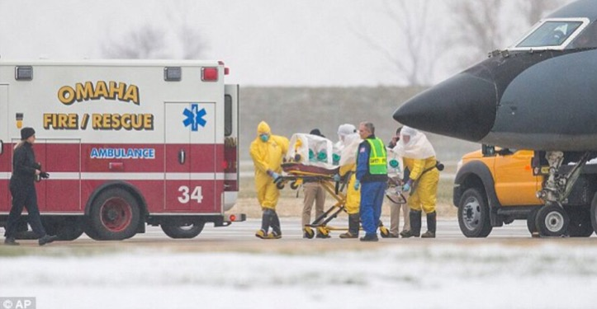
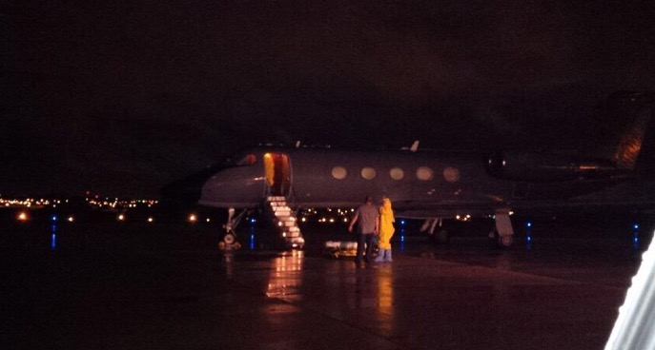
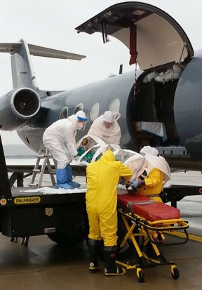
Medical Transport Experience
Coordinated multiple real-world medical isolation transports with DOS through Offutt Air Force Base and civilian airport

Slide 5
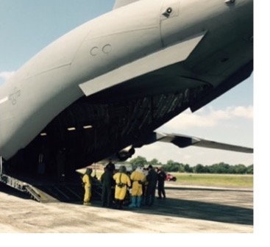
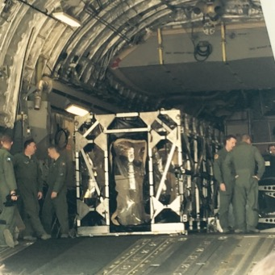
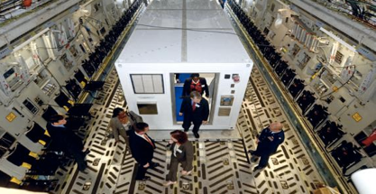
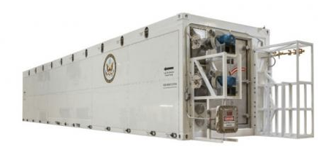
Medical Transport Experience
Supported and participated in July 2015 medical transport exercise with AMC, using PIU and TIS
Ted Cieslak, MD, UNMC Associate Professor, COPH Epidemiology, former Director of Clinical Services Division (USARMY MEDCOM) and Chief of the Medical Division, USAMRIID
John Lowe, Ph.D. UNMC Associate Professor, COPH Environmental, Agricultural, and Occupational Health, has led multiple patient management and transport events, and developed a training curriculum for medical transport
Wes Carter, NSRI, Director of Field Operations
& Training, former head of Emergency
Management, USAMRIID, Co-developer (CBCS)

Slide 6
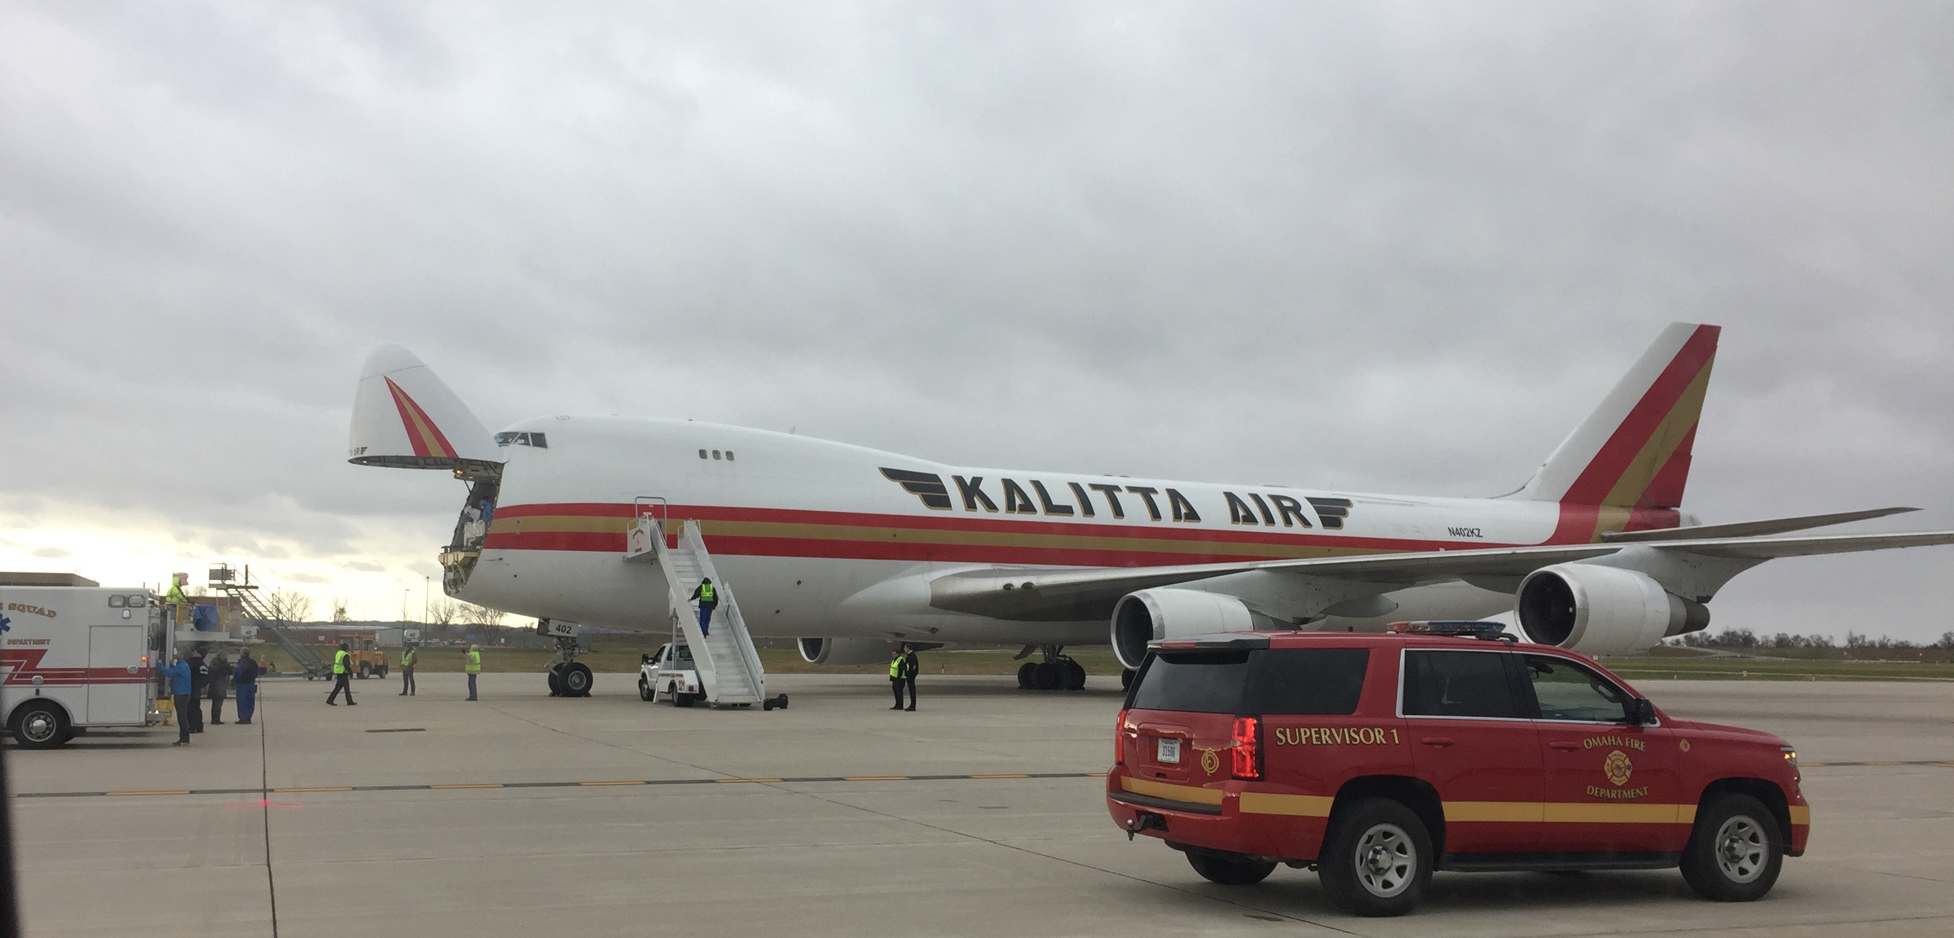
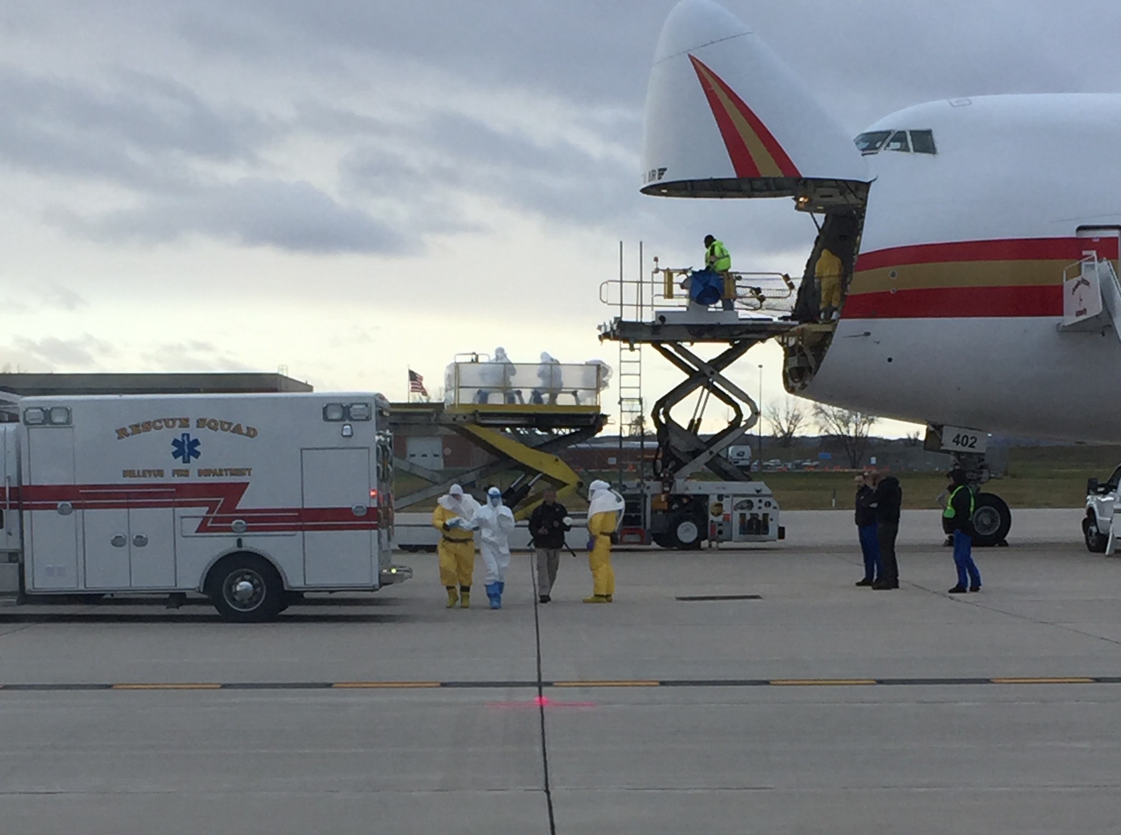
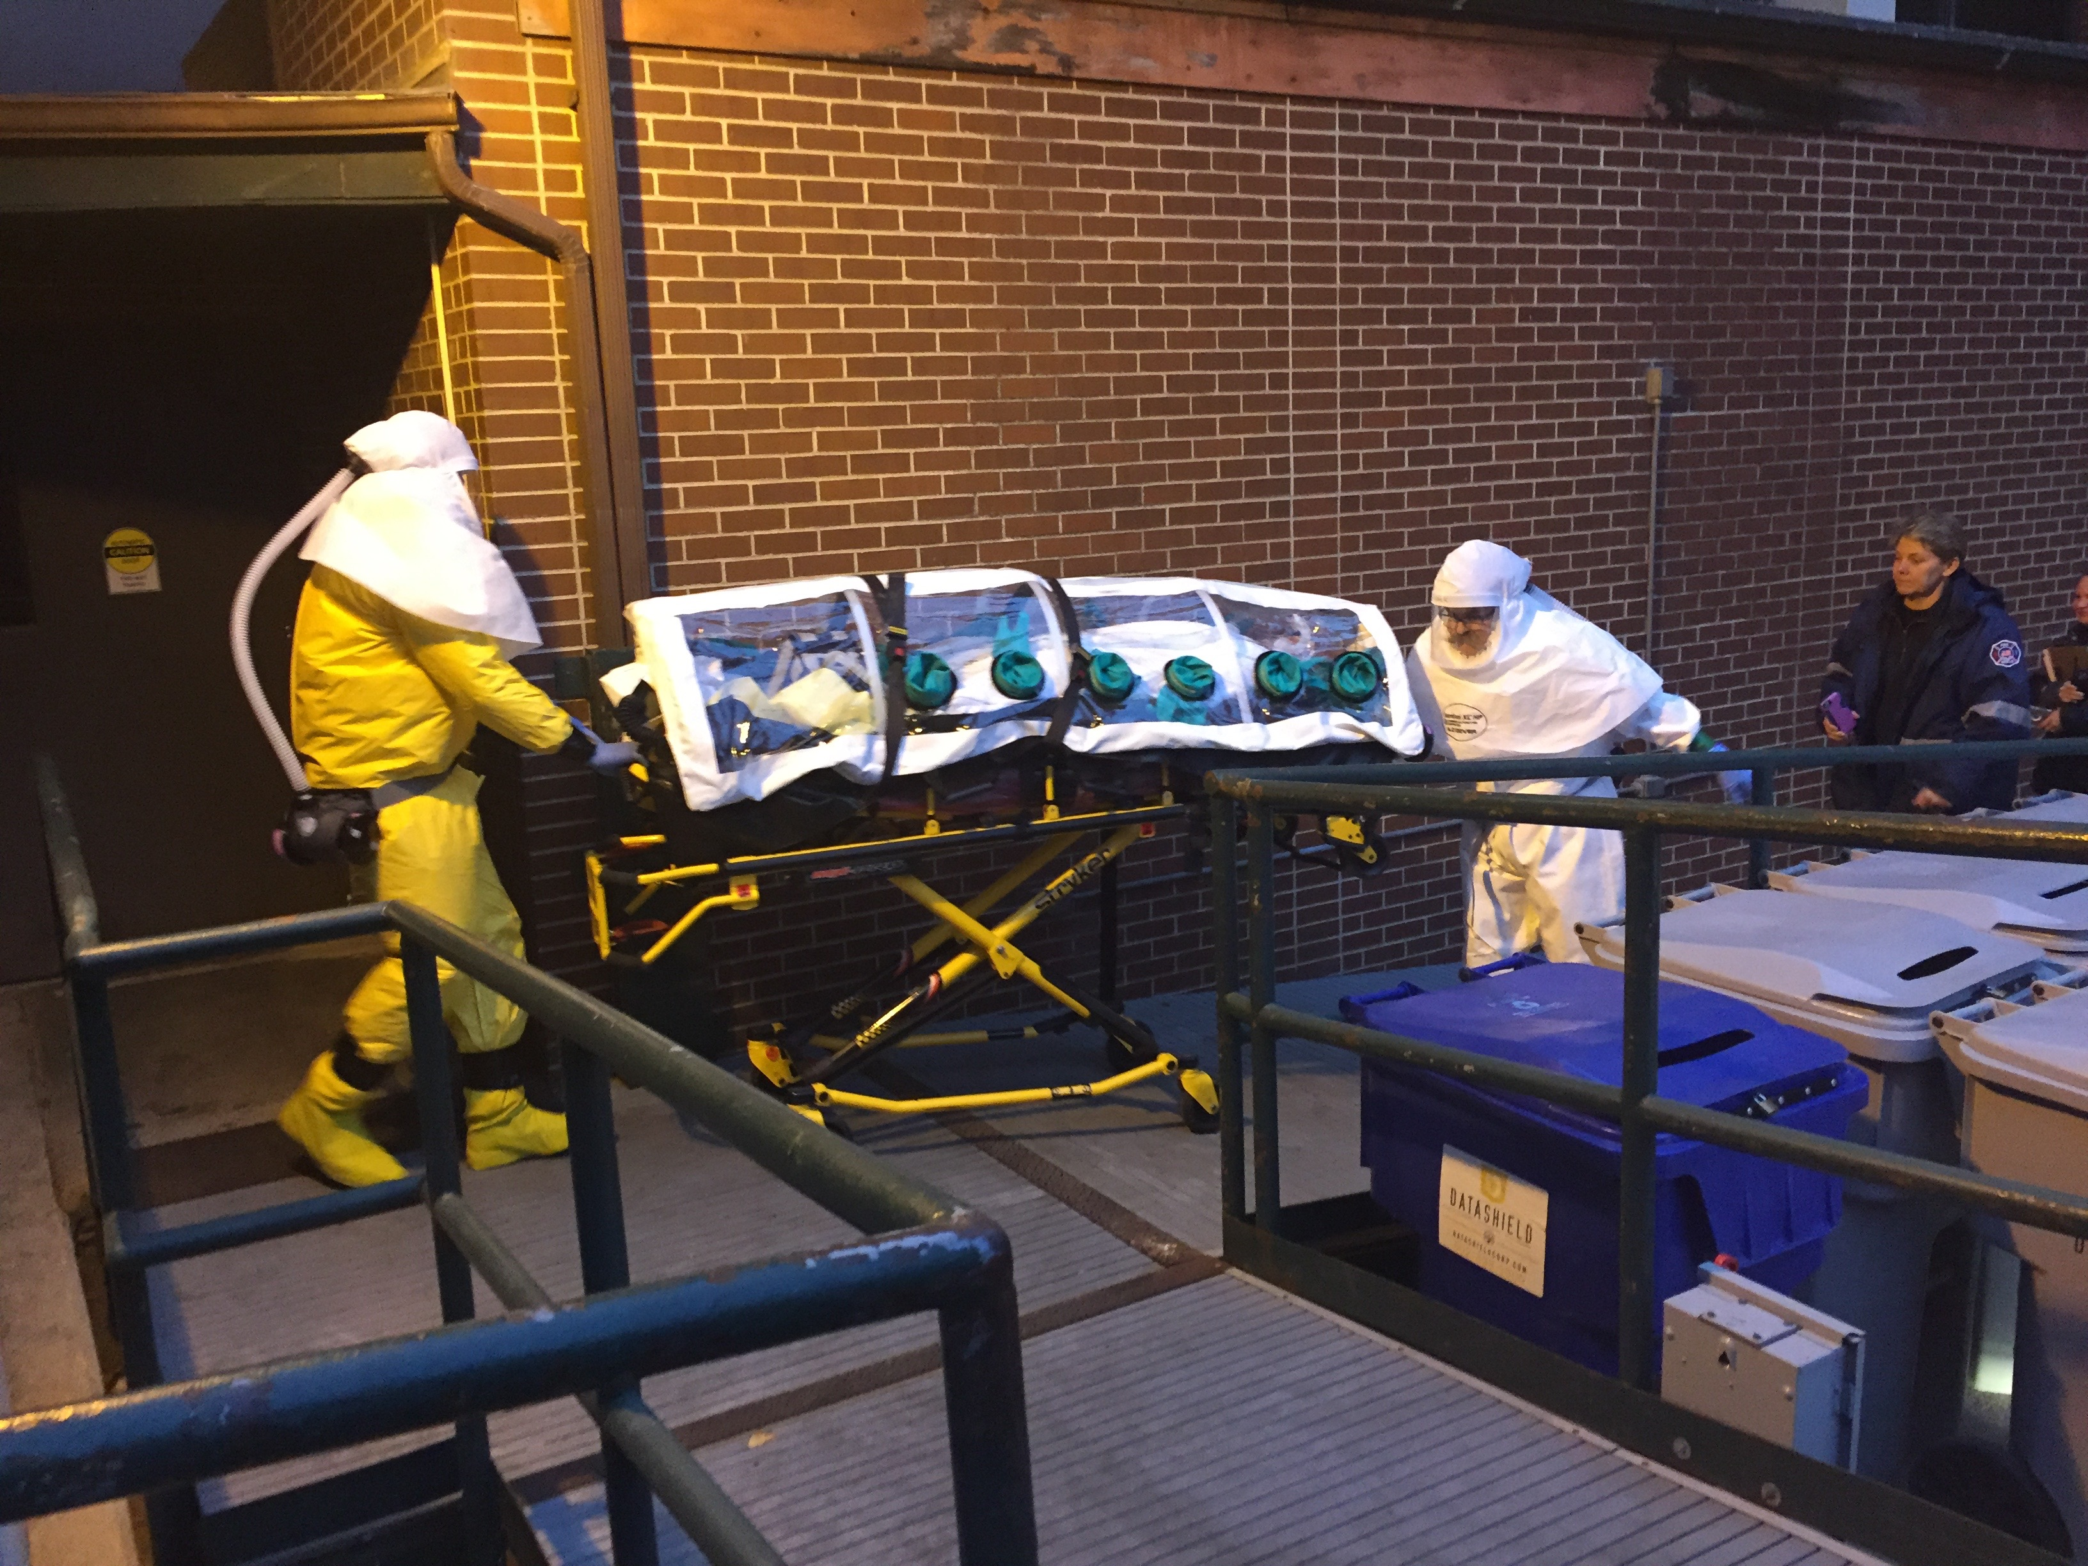
State Department Collaboration
International exercise with State Department in Nov 2016

Slide 7
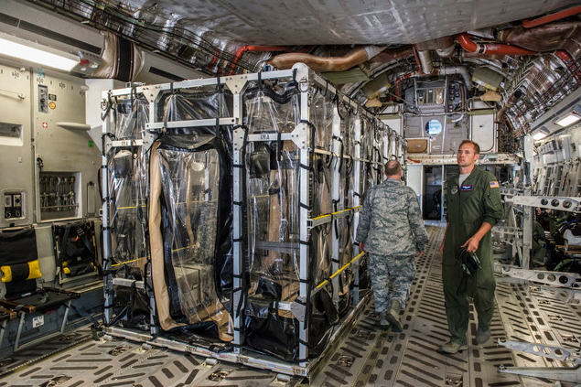
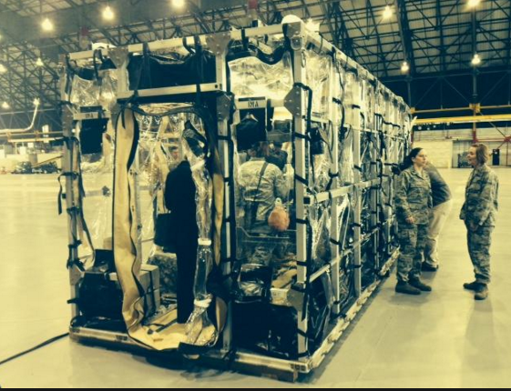
Department of Defense Collaboration
Transport Isolation System (TIS) was rapidly developed and deployed for response to the EVD outbreak in 2014
Systems were soft-sided in design, designed for non-aerosolized threats and rapid assembly by military transport staff

Slide 8
Nebraska Effort
Notes:
NBU was a collaborative effort between NE DHHS and NE Medicine. Local public health in Douglas County was at the table for the development of protocols ton activate the unit and the plans for activation included notification of local public health.
Planning for a potential Ebola response kicked into high gear following transport of the first two patients to Emory and the U.S. State Department visit to NBU
DCHD tested the hotline
Developed protocols in advance of most CDC guidance
Assured, in coordination with NE DHHS and NPHL that testing and specimen transport protocols were in place and understood

Slide 9
Coordination
U.S. Department of State
U.S. Centers for Disease Control Nebraska Biocontainment Unit
Omaha Fire EMS
State and Local Public Health
Law Enforcement
Nebraska State Patrol Omaha Police Department U.S. Federal Bureau of Investigation
County Emergency Management
Hospital Security
Notes:
NBU was a collaborative effort between NE DHHS and NE Medicine. Local public health in Douglas County was at the table for the development of protocols ton activate the unit and the plans for activation included notification of local public health.
Planning for a potential Ebola response kicked into high gear following transport of the first two patients to Emory and the U.S. State Department visit to NBU
DCHD tested the hotline
Developed protocols in advance of most CDC guidance
Assured, in coordination with NE DHHS and NPHL that testing and specimen transport protocols were in place and understood

Slide 10
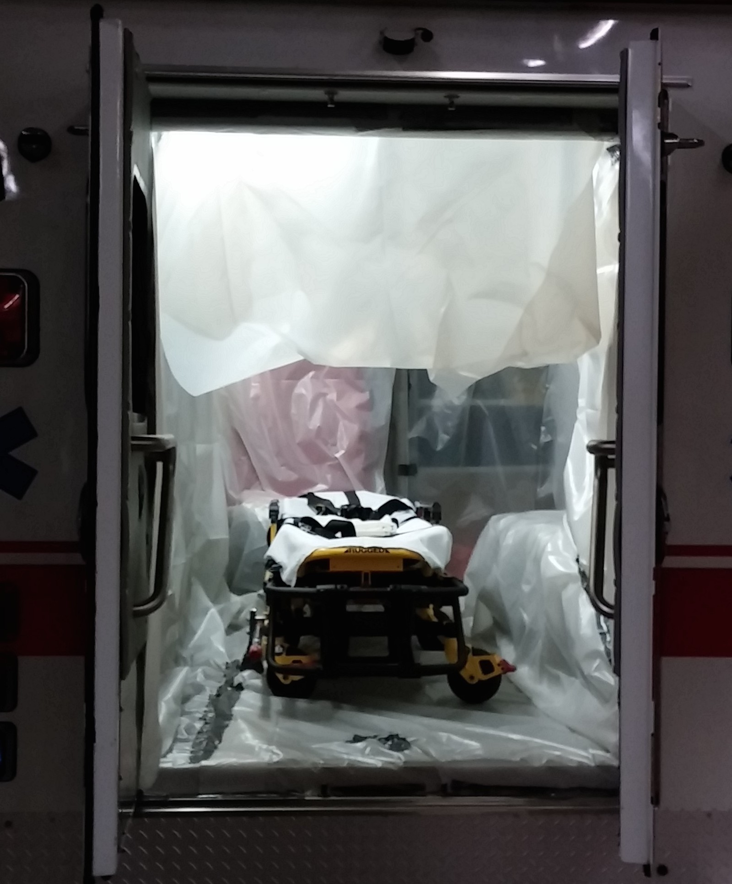
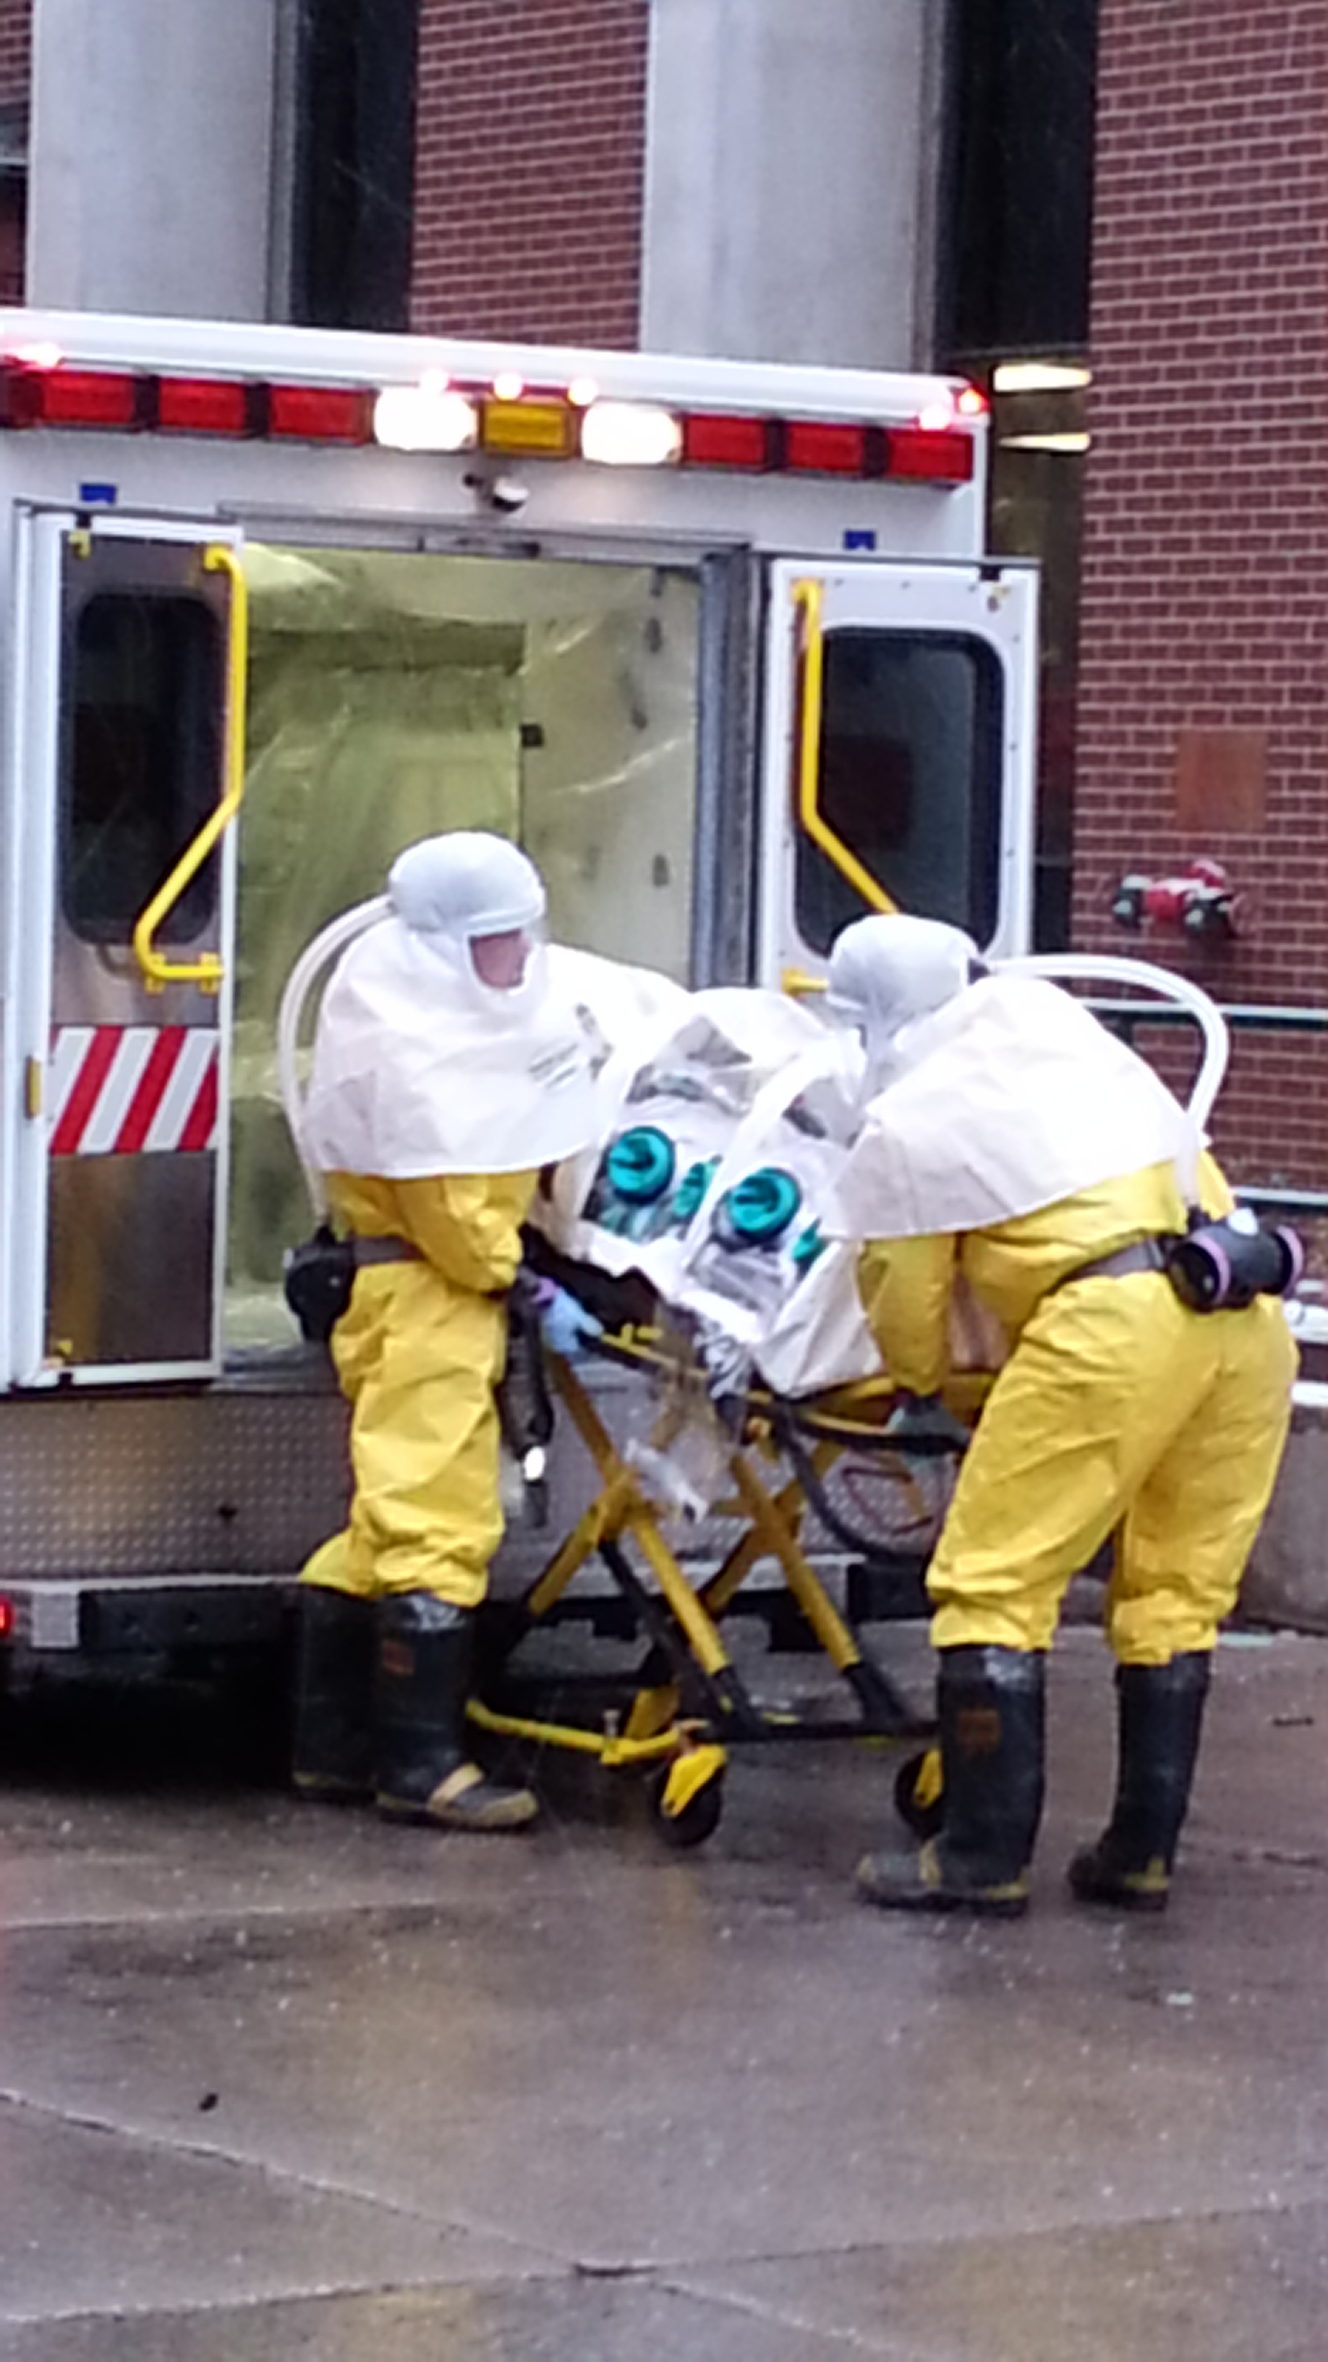
Patient Transport
EMS from airport to Nebraska Biocontainment Unit
UNMC 2014
Lowe et al. "Considerations for Safe EMS Transport of Patients Infected with Ebola Virus." Prehospital Emergency Care (2014). http://dx.doi.org/10.3109/10903127.2014.983661
Notes:
Draping procedure
Driver isolated from back compartment
Privacy drape
Facility transport
Transport team
Hospital, EMS, blended team
Site and route of entry into facility
Security
Environmental disinfection
U.S. Department of State
Nebraska State Patrol
Omaha Police Department
U.S. Federal Bureau of Investigation
Nebraska Division of Public Health
County Emergency Management
Nebraska Medical Center Security

Slide 11
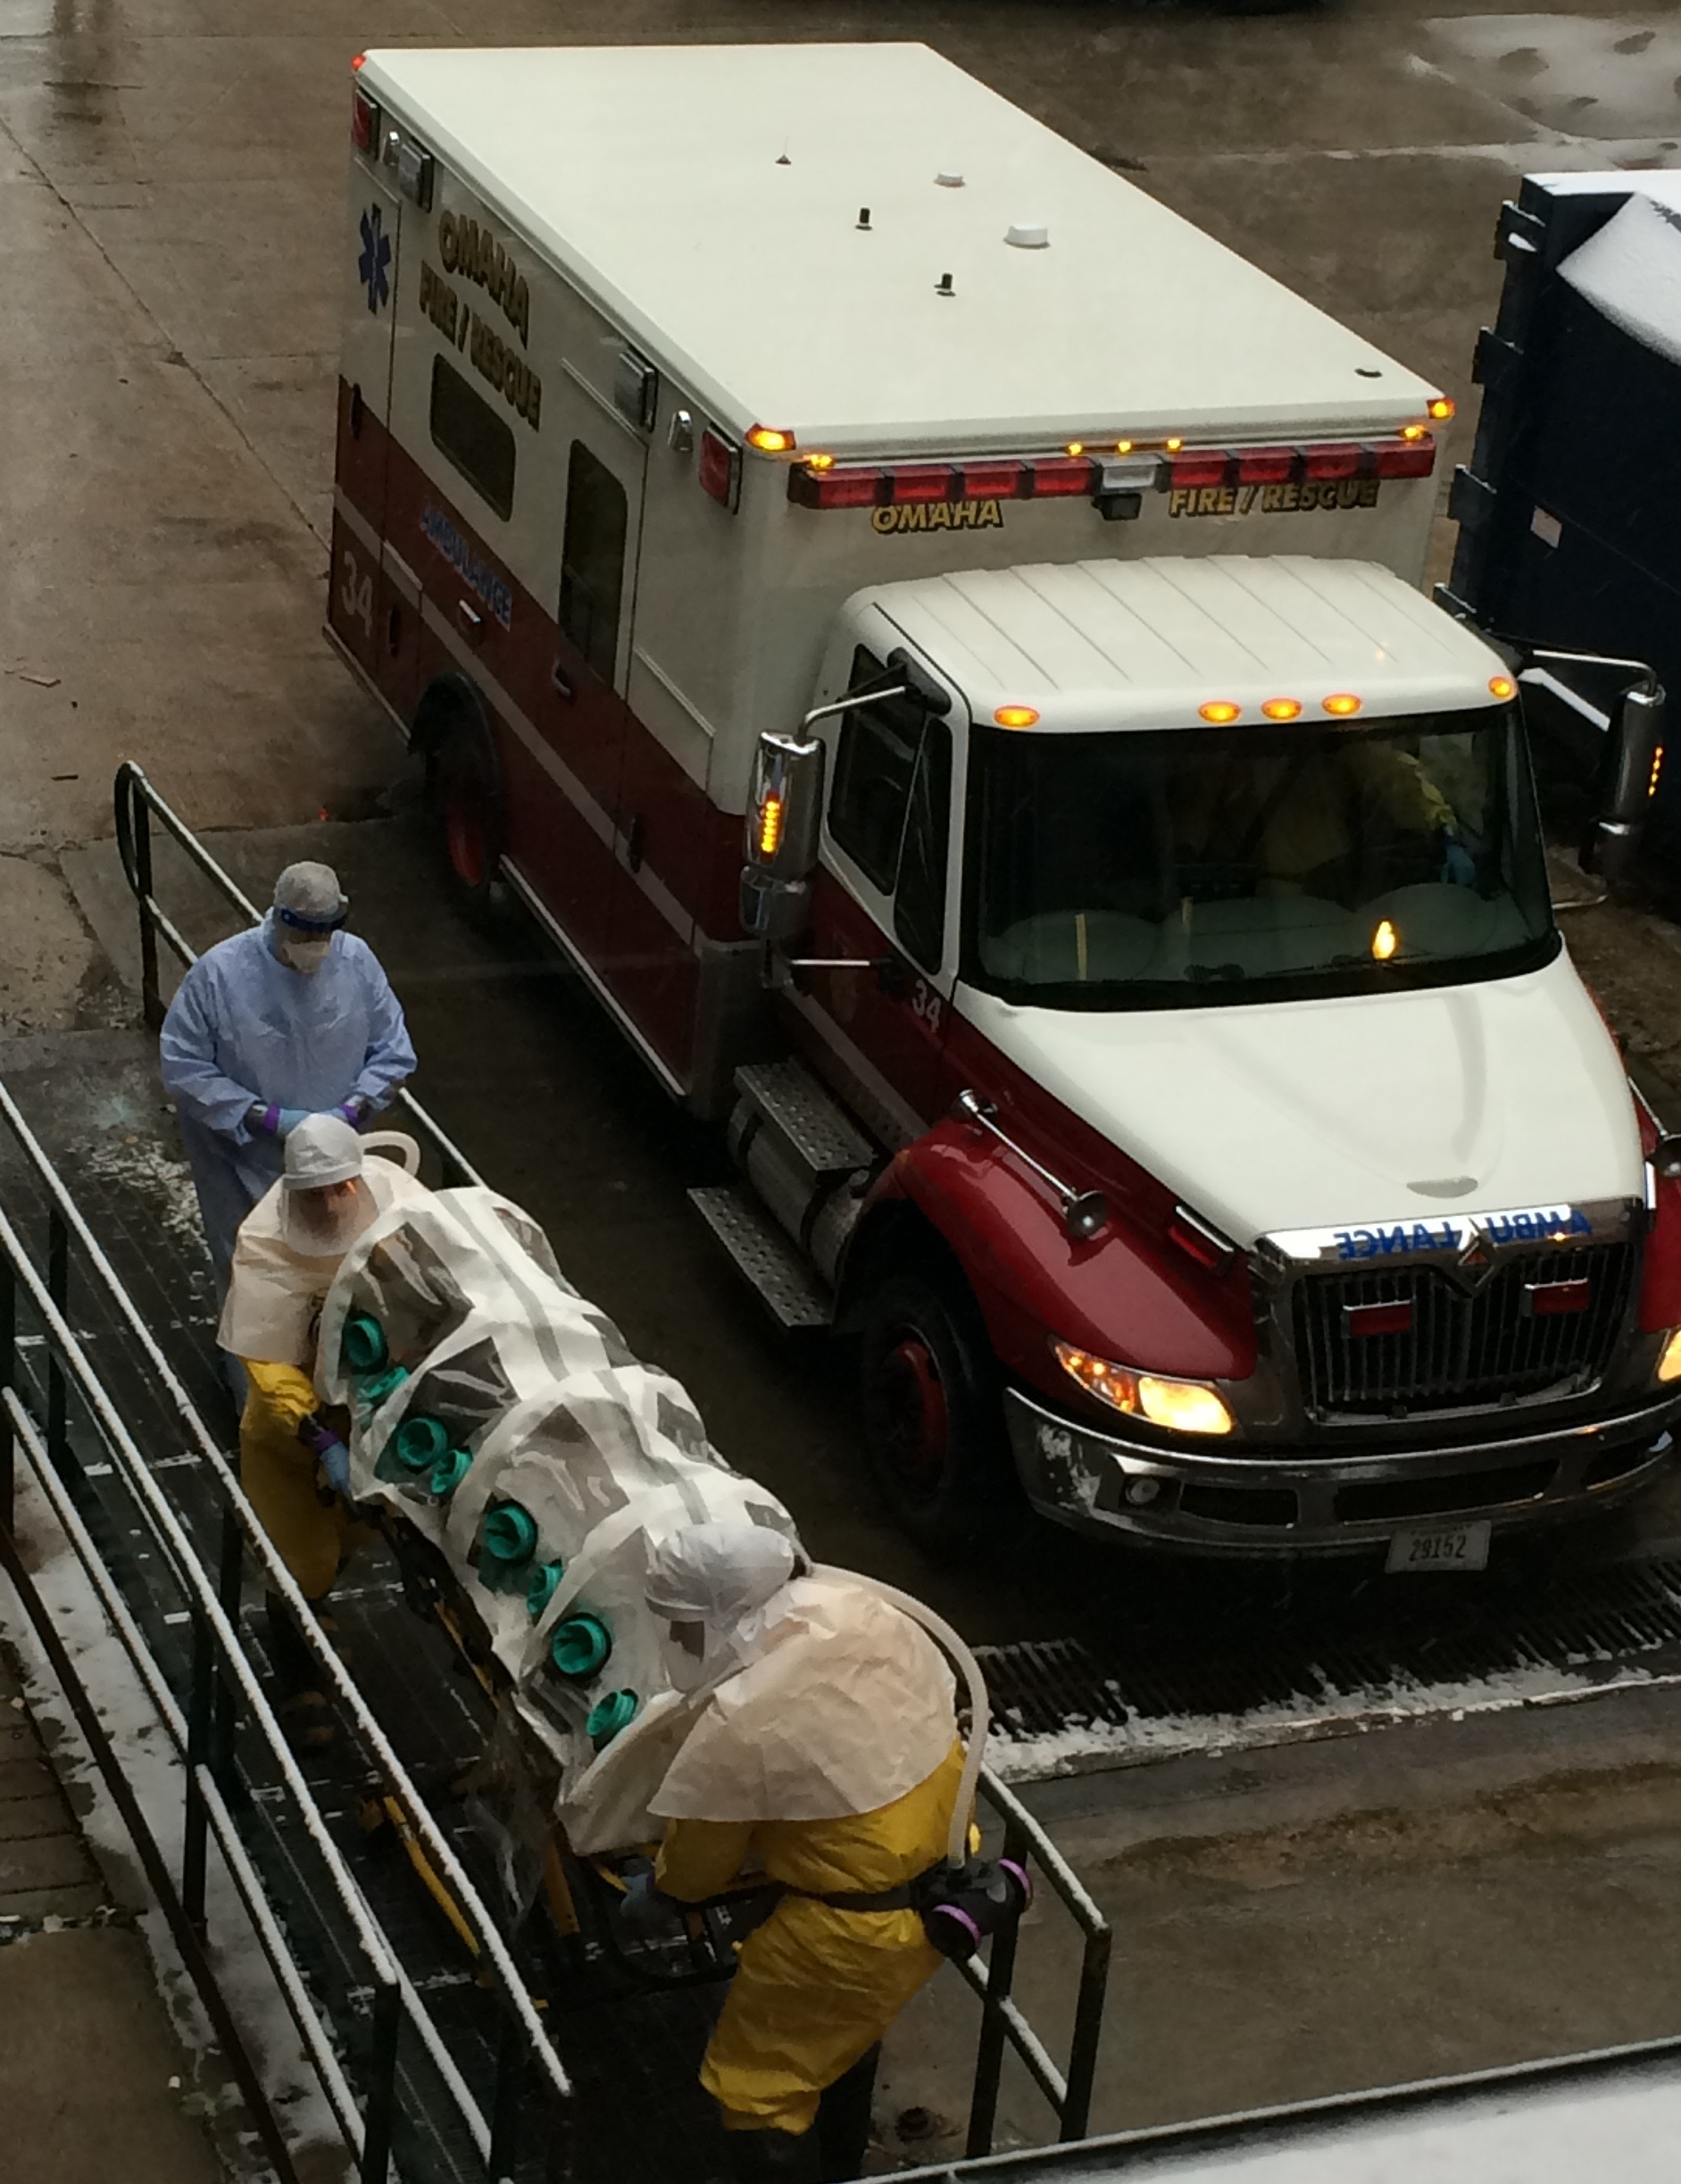
Protective Equipment
UNMC 2014

Slide 12
EMS Personnel PPE
Ray Soderlin / The World-Herald
UNMC 2014
Notes:
BCU personnel PPE
Tychem suit and PAPR – Level III
Patient isolation – isopod
Appropriate PPE
Tychem suit
Full face respirator (Panther – bio/chem? look up name)
Gloves/booties

Slide 13
Waste Handler PPE
UNMCheroes.org
Biocontainment Unit staff handle all waste processing: Nurses, Medical Technicians, & Industrial hygienists
 | Containers | Cubic meters | Weight (kg)
Patient 1 | 101 | 13.15 | 458.8
Patient 2 | 88 | 11.0 | 819.4
Patient 3 | 34 | 4.42 | 399.2
Healthcare and Emergency Responder Organization Education Through Simulation. Personal Protective Equipment: Biological Level-C Doffing. Omaha: University of Nebraska Medical Center, 2010 Available at 2014.
http://app1.unmc.edu/nursing/heroes/mpv.cfm?updateindex=53&src=yt Accessed October 29, 2014

Slide 14
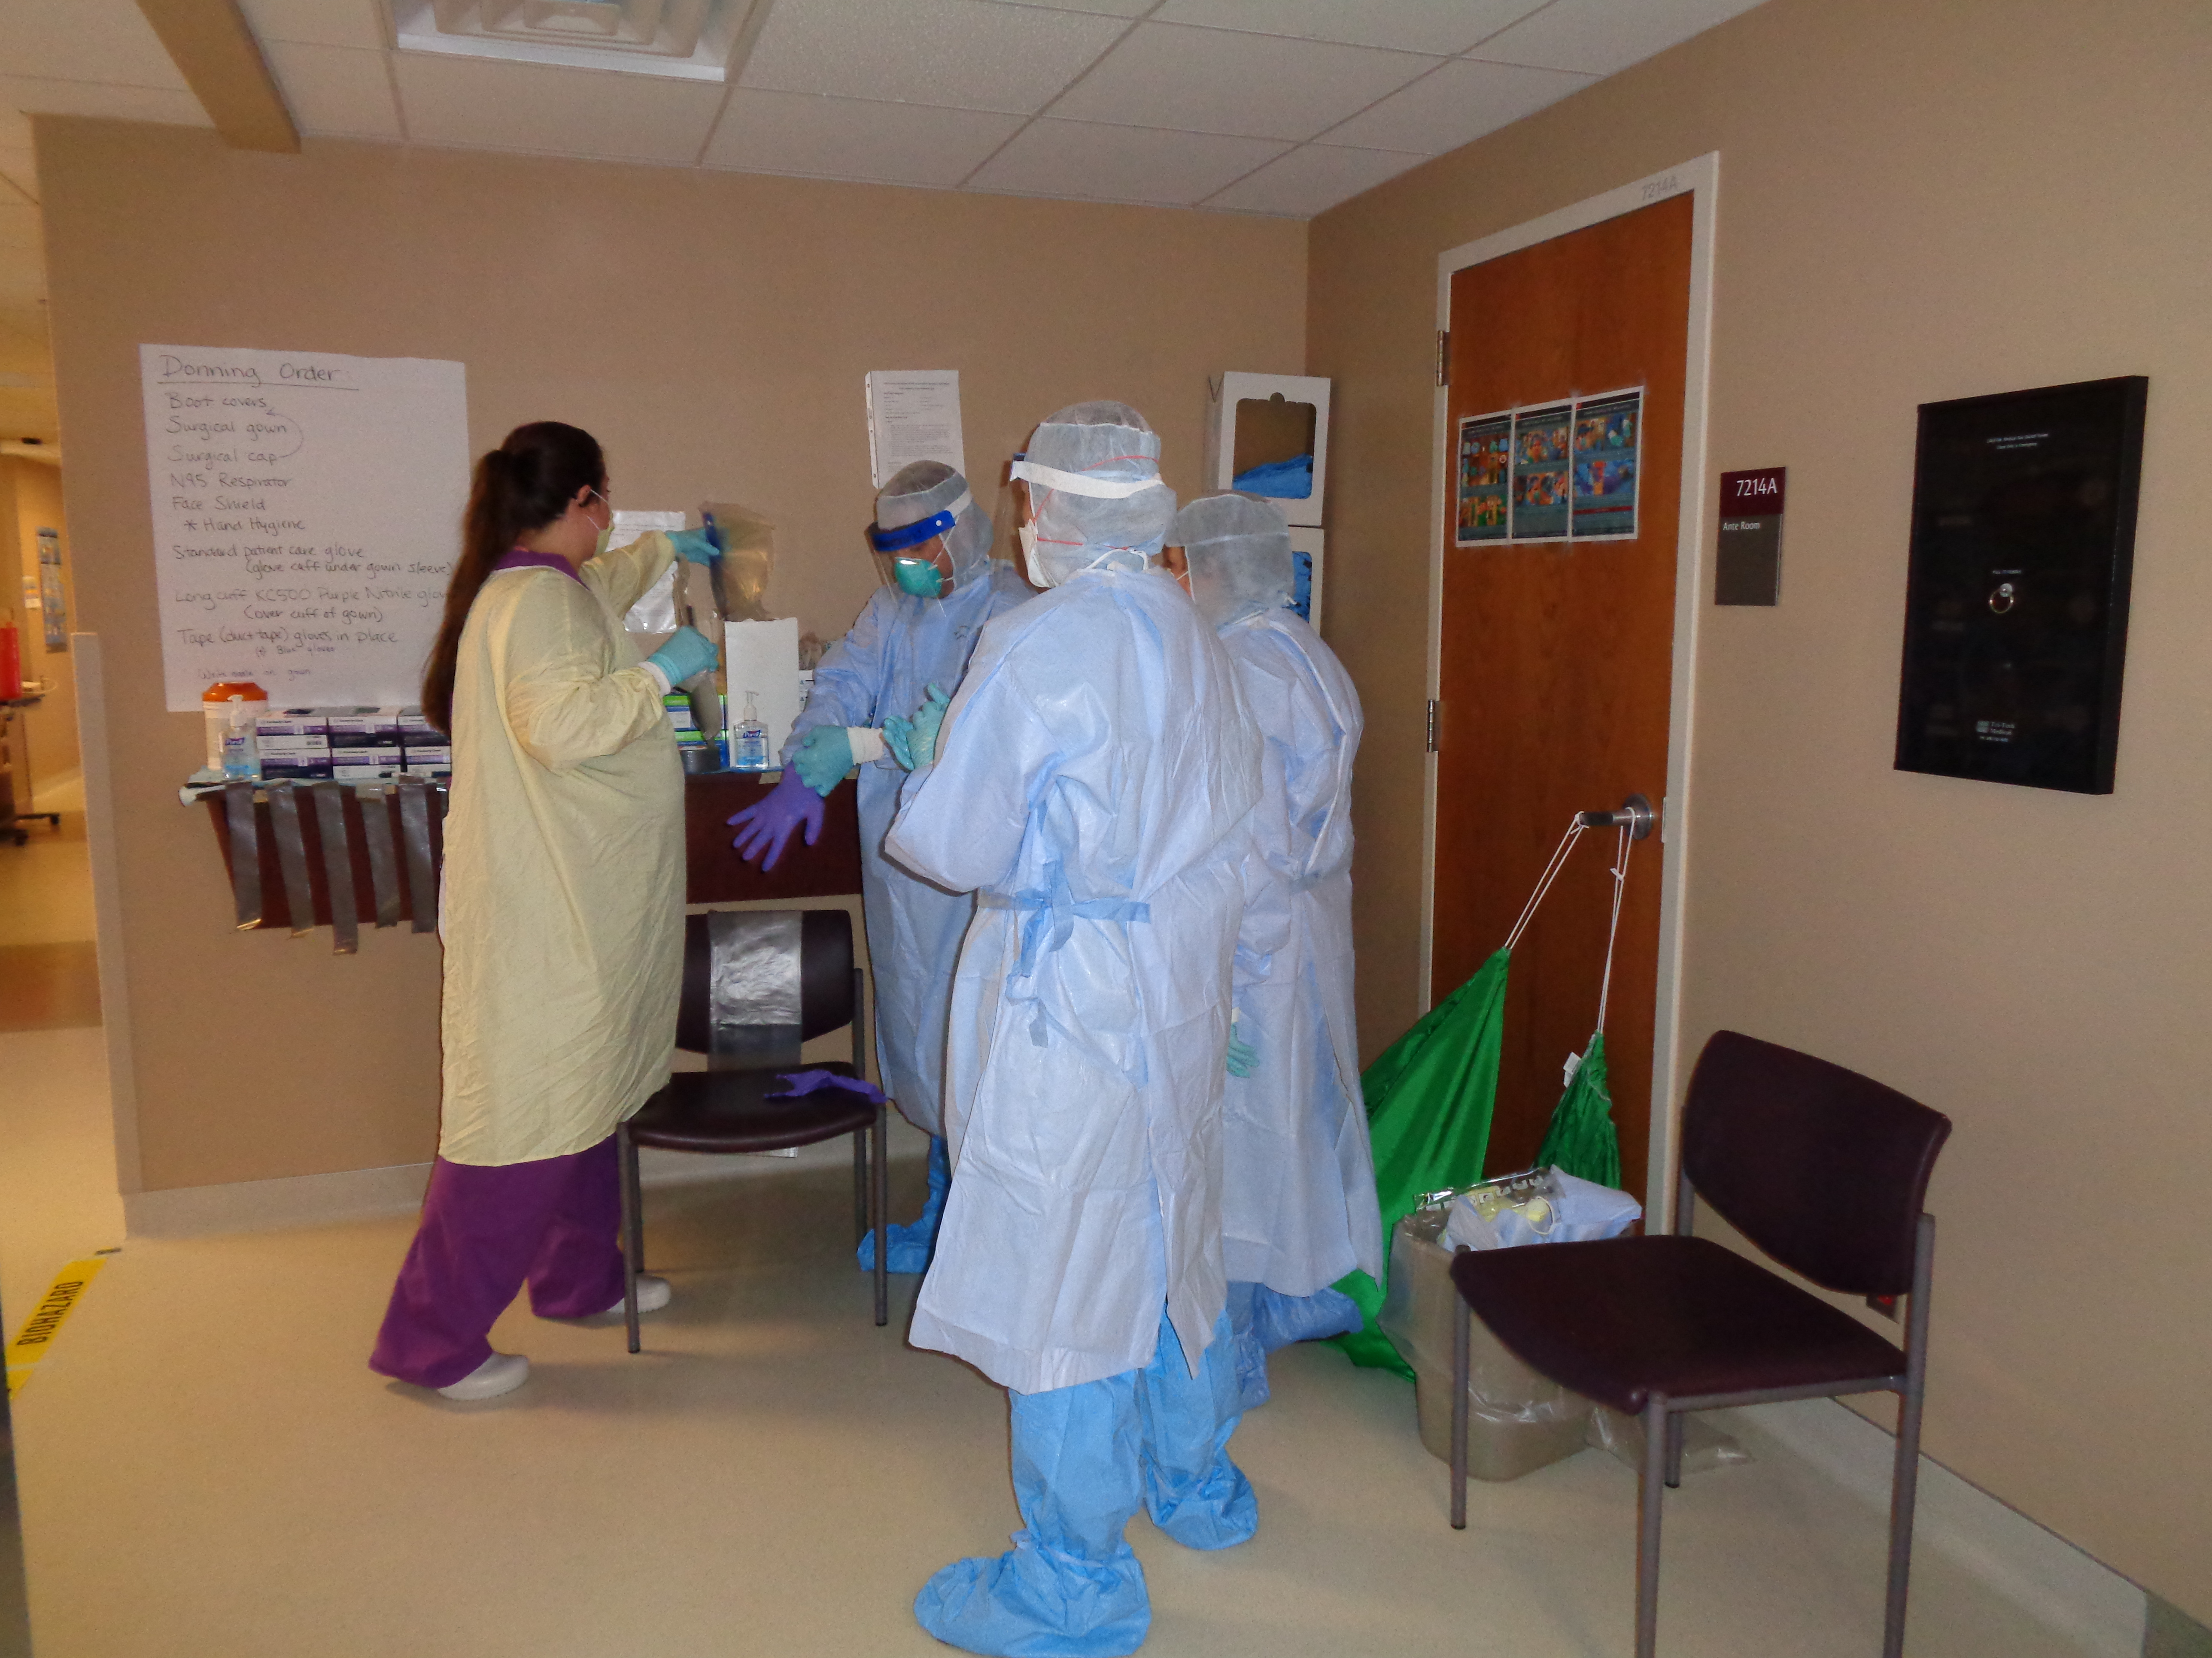
Operational Lessons Learned
Personal protective equipment
Need to assess type of PPE necessary based on the condition of the patient
Maintain the ability to scale up or down
Most important aspect of utilizing appropriate PPE is the supervision of the donning and doffing process

Slide 15
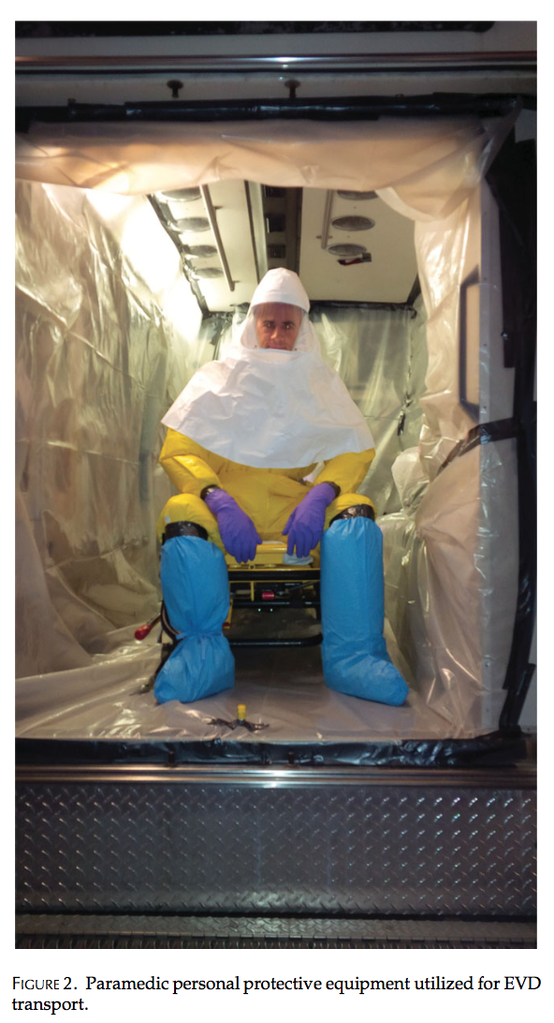
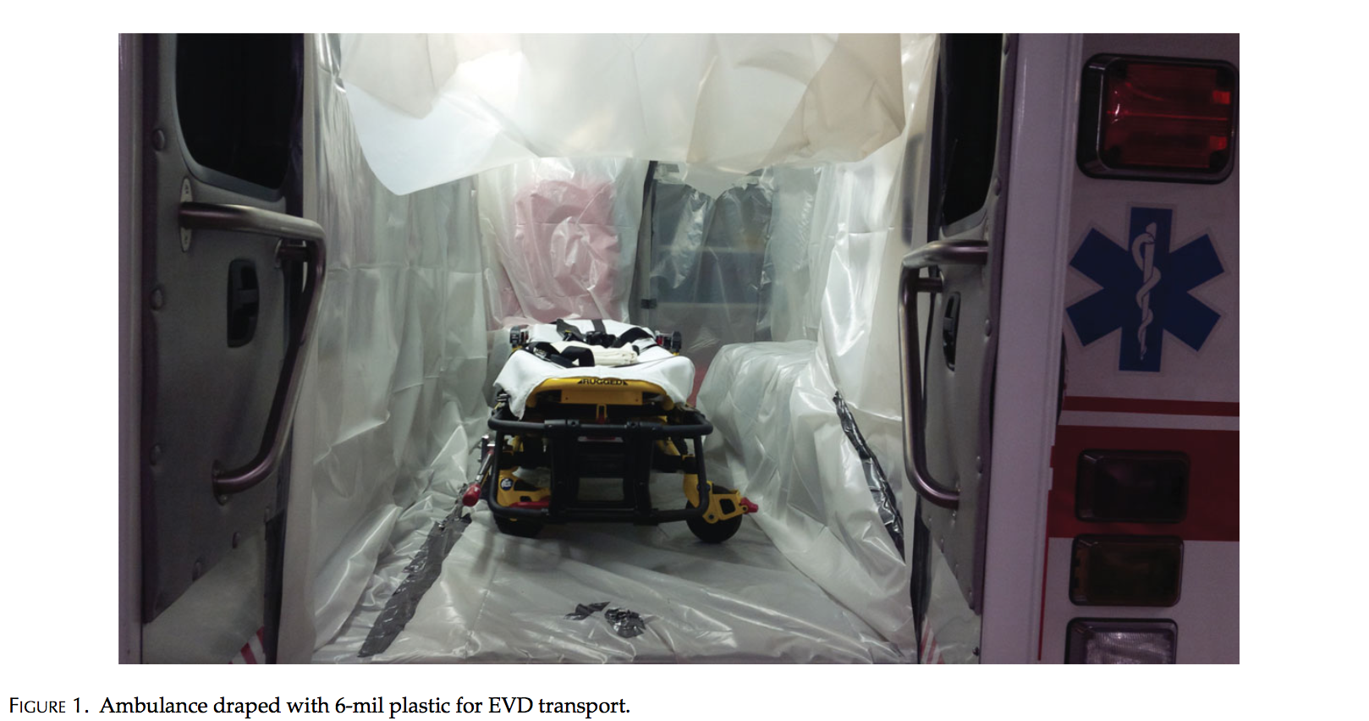

Slide 16
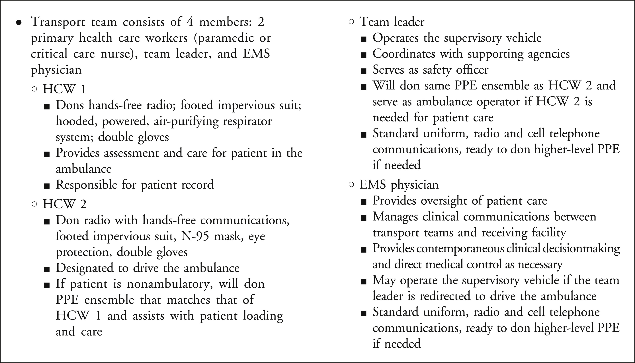

Slide 17
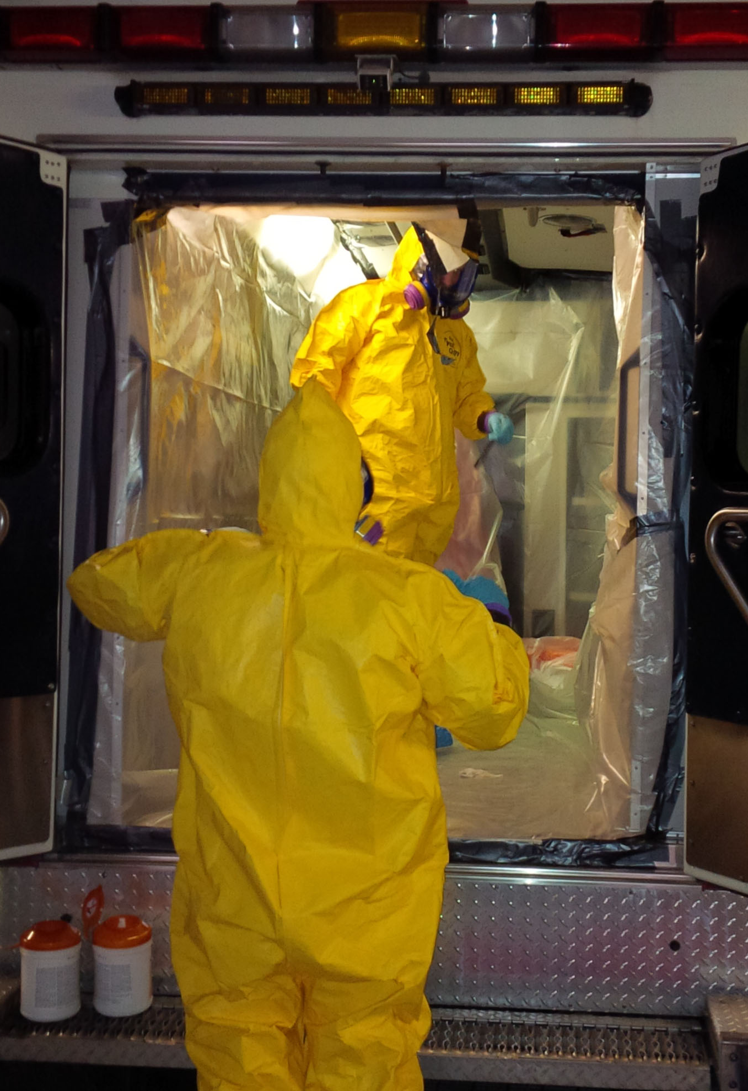
Ambulance Decontamination
UNMC 2014
Lowe et al. "Considerations for Safe EMS Transport of Patients Infected with Ebola Virus." Prehospital Emergency Care (2014). http://dx.doi.org/10.3109/10903127.2014.983661
Notes:
Cab wipe down
Wrap plastic draping
Autoclaved – Cat B waste stream
Full bleach wipe down (2x)
UVGI
Stand down time? CHECK

